Slide 1


TEMPORAL VARIATION OF CRIME IN TARTU AND TARTU MUNICIPALITY
PLANNING PROJECT
Rachid Berghout

Slide 2

1
DESCRIPTIVE ANALYSIS
Describe the nature of the data to be analyzed and Scrutinizing it in a set of independent variables from which the change in dependent variables arises.
OUTLINE
DATA PROCESSING
2
A sequence of operations are performed on the given set of data to extract the required information in an appropriate form or model, Most of the data processing is done by using RStudio, SPSS, Excel.
STATISTICAL ANALYSIS
3
Creating and interpreting Models to summarize understanding of how the mentioned variables relate to each other, to identify crime events trends and run crime scenarios in Tartu.

Slide 3

1
Yearly distribution of crime events
1512
2018
1595
2017
2023
2016
1892
2015
2357
2014
97%
Is the percentage of crime numbers in Tartu city, which is significantly dominant in
comparison with number of crime in Tartu Municipality. In five years period, the crime rates
has decreased from 2357 in 2014 to 1512 in 2018.
Total

Slide 4
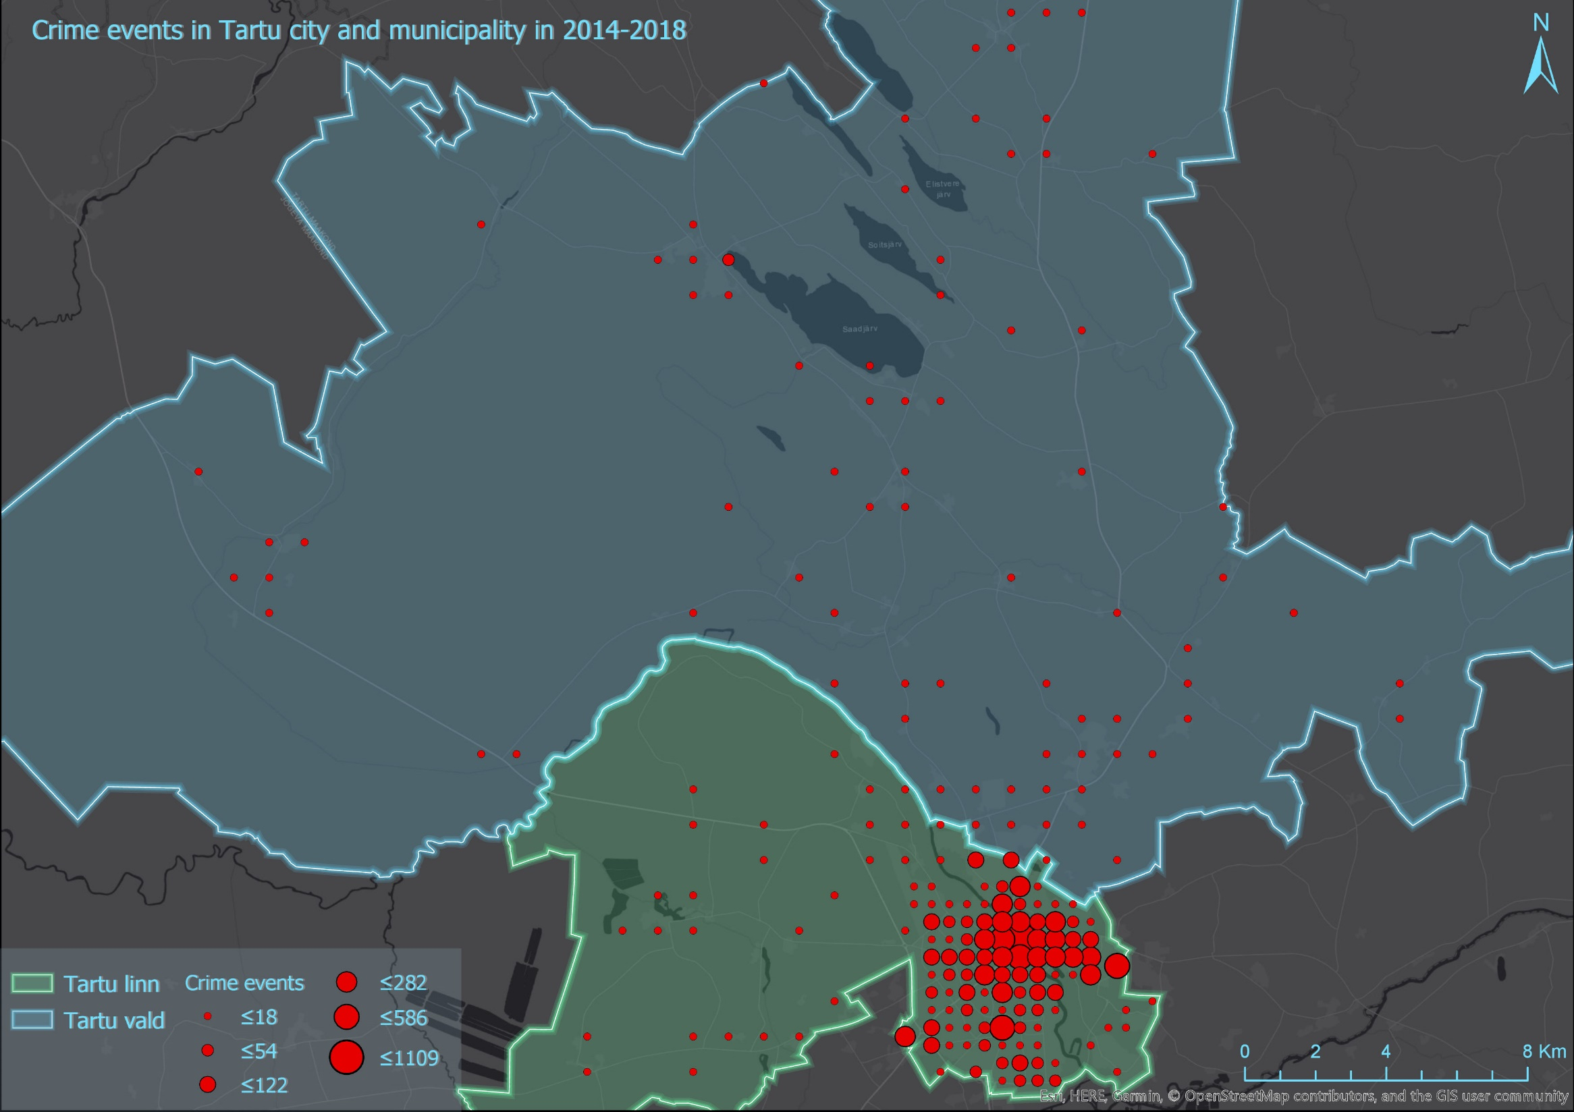
1

Slide 5
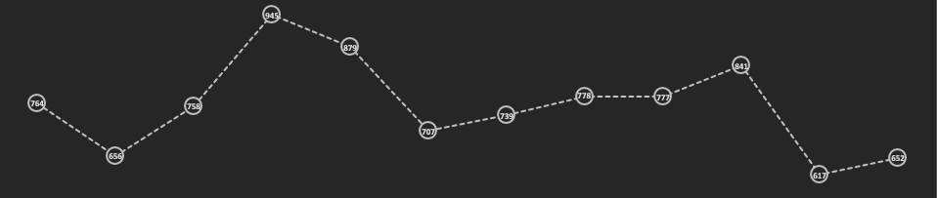
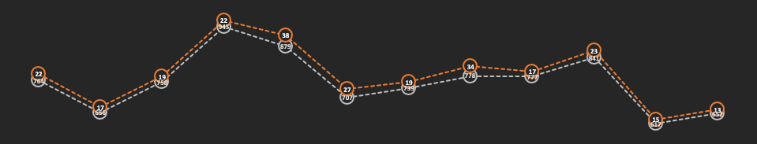
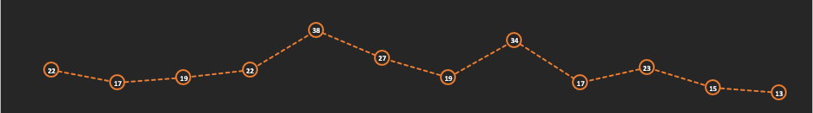
1
Tartu City
Tartu Municipality
Monthly distribution of crime events

Slide 6
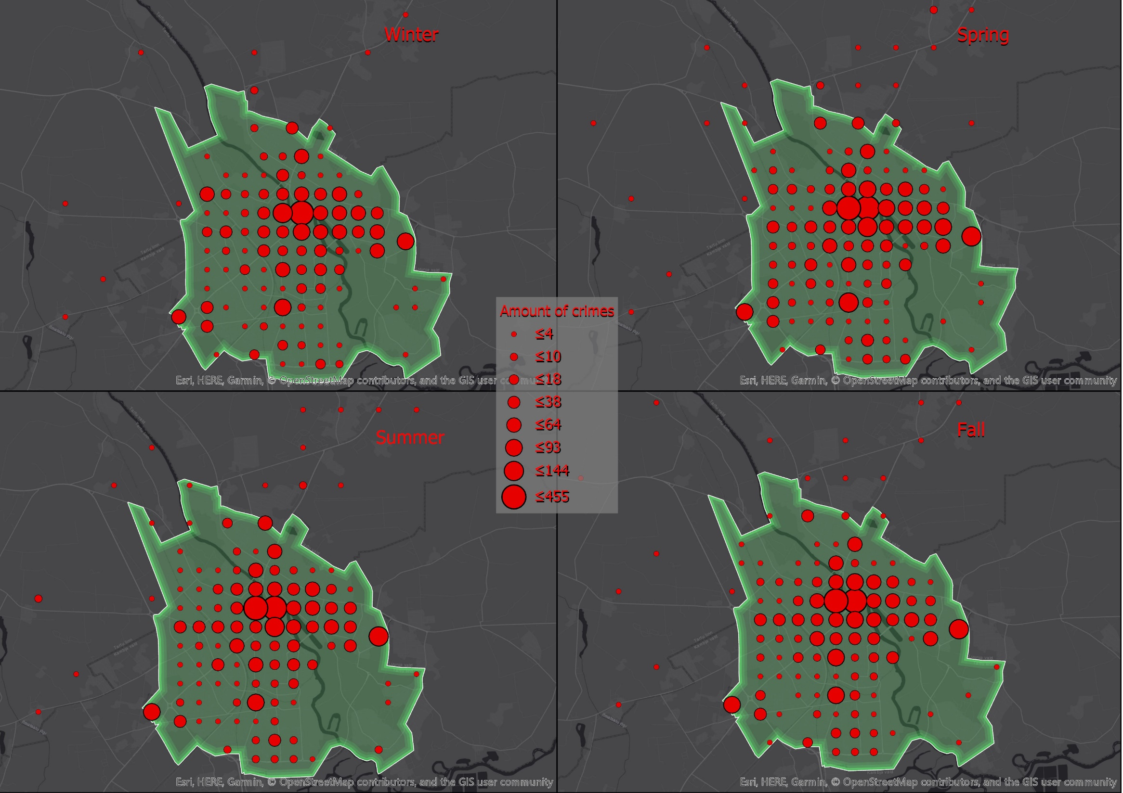
1
Winter
Spring
Summer
Fall

Slide 7
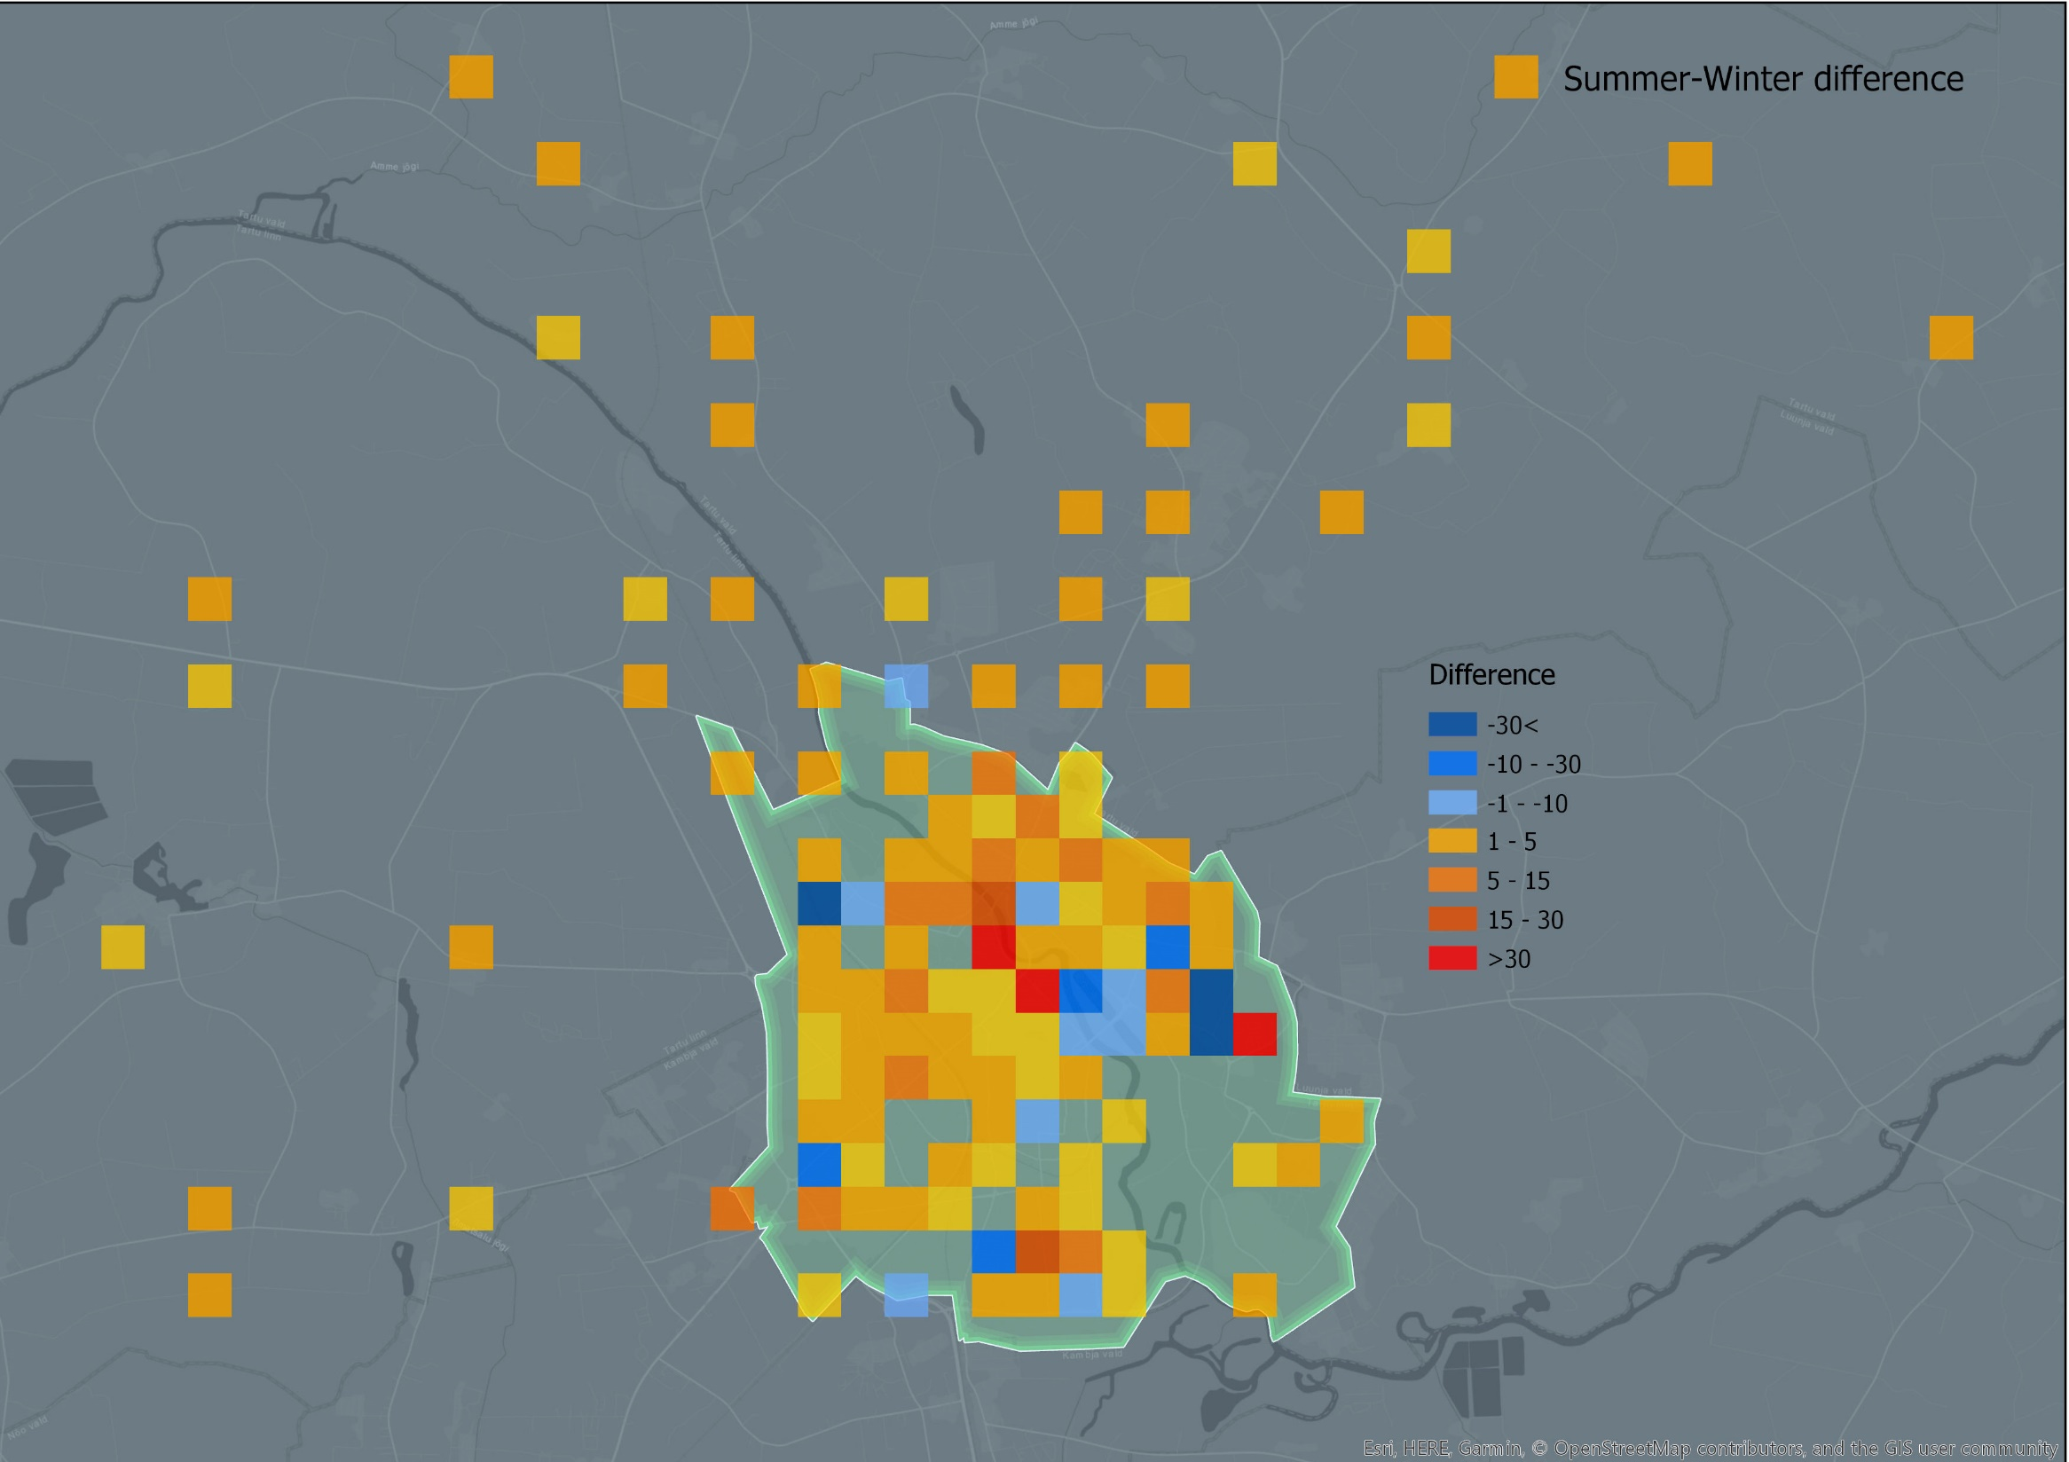
1

Slide 8
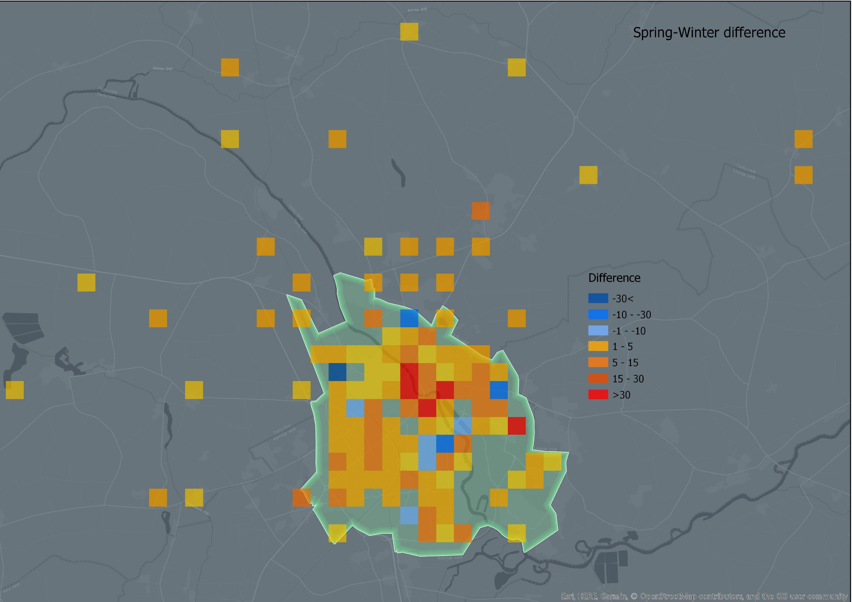
1

Slide 9
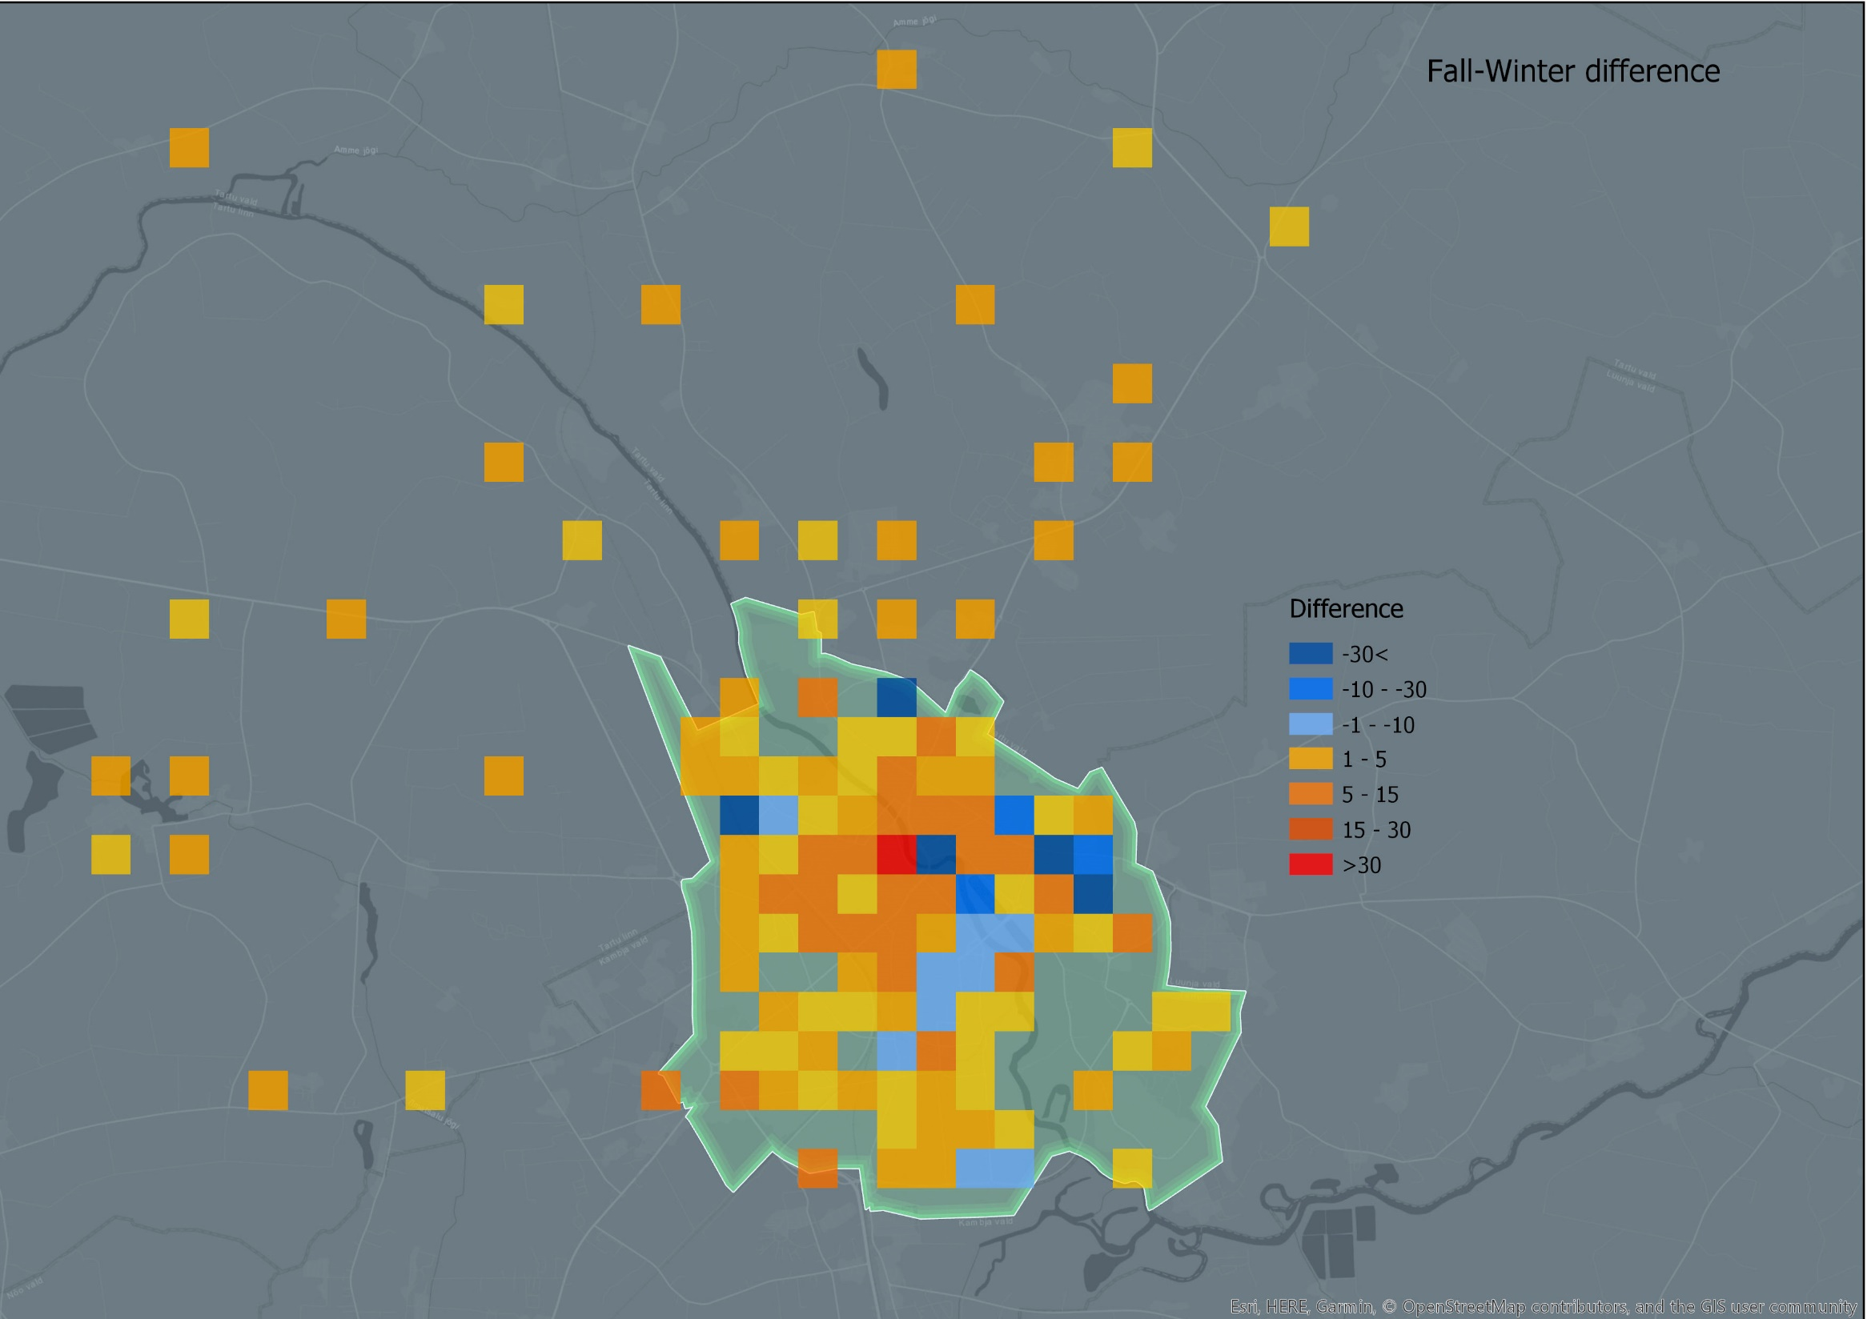
1

Slide 10
1
Daily distribution of crime events
10

Slide 11
1
Hourly distribution of crime events
Tartu City
Tartu Municipality

Slide 12
1
Hourly distribution of crime events
Tartu City
Tartu Municipality

Slide 13
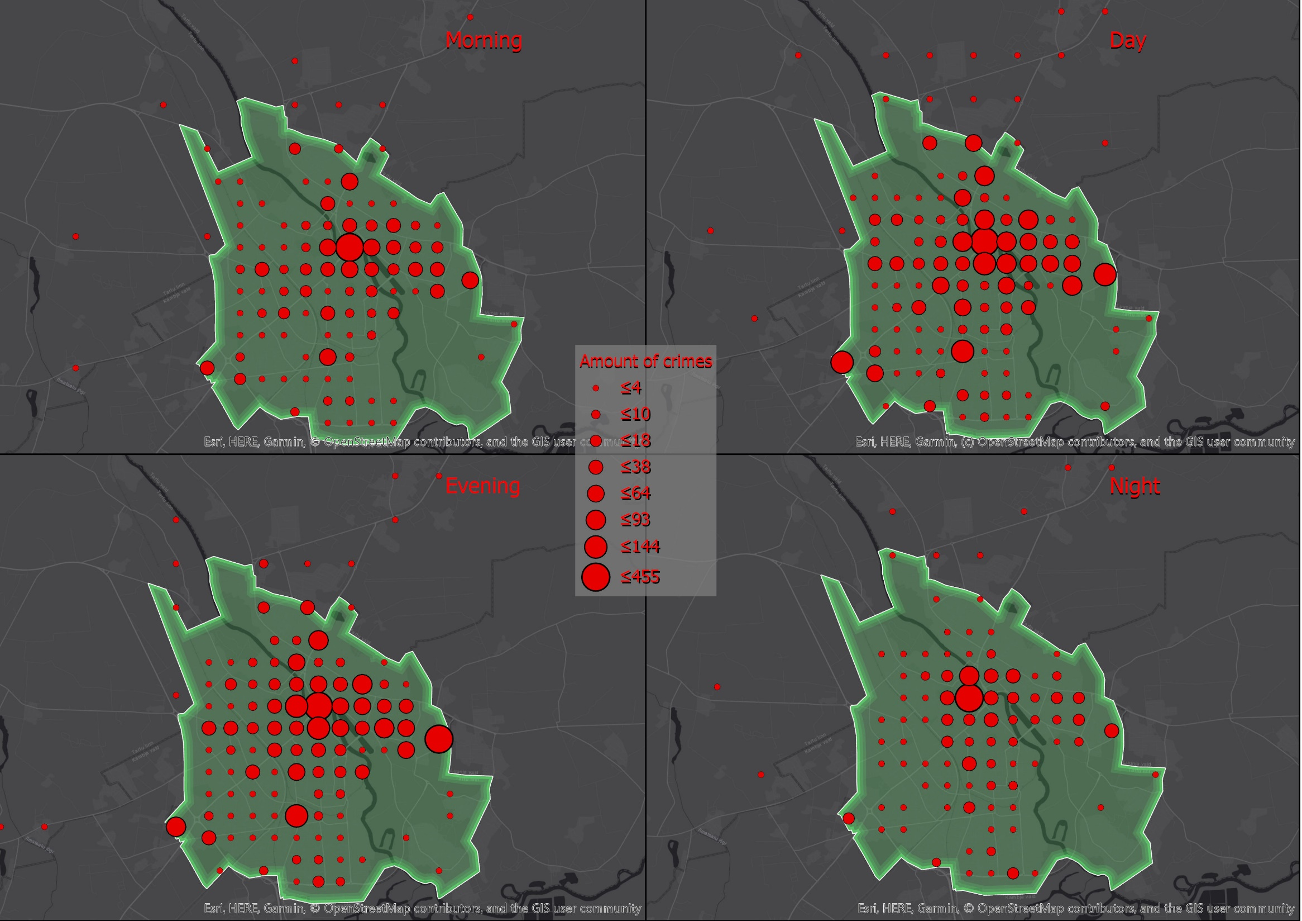
1
Morning
Day
Evening
Night

Slide 14




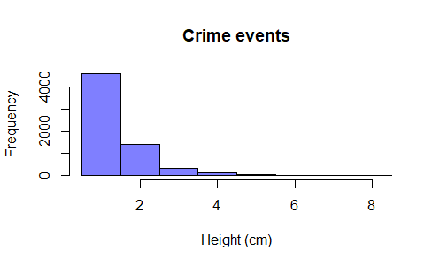
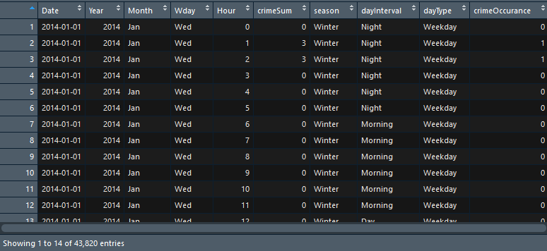
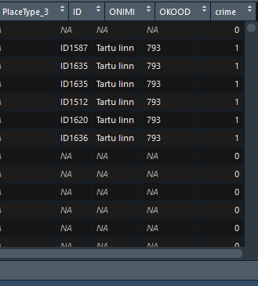
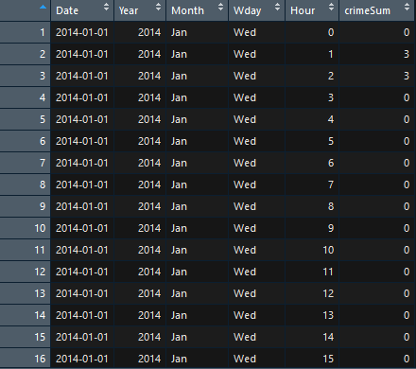
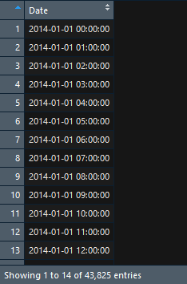
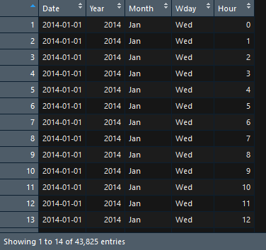
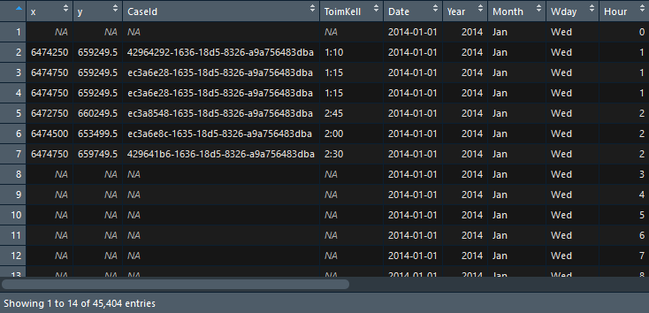
2
1 - Create time interval table with each row represents one hour from 2014-2018
2 - Transform the table by splitting the date time column to y, m, d and h.
3 - Join this table with initial crime data table
4 - Create additional column with crime number - 1 or 0
5 - Group by date, year, month, day, hour and summarize crime number column
6 - Add additional categories to reduce amount of variables for analysis
6
4
5
1
2
3

Slide 15
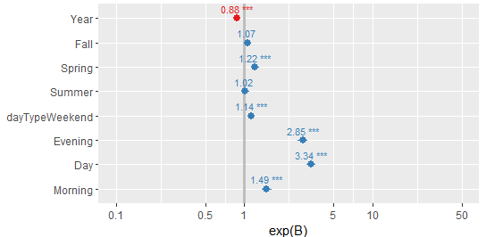

estimate std.error p.value conf.low conf.high exp.B.
3
conf.Low
Exp
conf.High
Exp
Intercept
260.757 | 17.282 | 1.95E-51 | 226.914 | 294.663 | 1.76E+113 | 3.53E+98 | 9.35E+127
Year
-0.130 | 0.008 | 1.79E-52 | -0.147 | -0.113 | 0.877 | 0.862 | 0.892
(ref = Winter) Fall
0.064 | 0.034 | 0.0631 | -0.003 | 0.132 | 1.066 | 0.996 | 1.141
(ref = Winter) Spring
0.196 | 0.033 | 5.13E-09 | 0.130 | 0.262 | 1.217 | 1.139 | 1.300
(ref = Winter) Summer
0.017 | 0.035 | 0.6165 | -0.051 | 0.086 | 1.017 | 0.950 | 1.090
(ref= Weekday) Weekend
0.131 | 0.025 | 3.88E-07 | 0.080 | 0.181 | 1.140 | 1.083 | 1.199
(ref = Night) Day
1.206 | 0.040 | 4.03E-197 | 1.128 | 1.286 | 3.343 | 3.091 | 3.620
(ref = Night) Evening
1.049 | 0.041 | 8.07E-144 | 0.968 | 1.130 | 2.854 | 2.635 | 3.095
(ref = Night) Morning
0.401 | 0.045 | 1.46E-18 | 0.312 | 0.491 | 1.494 | 1.366 | 1.634
Temporal variations in crime occurrence: Tartu City

Slide 16
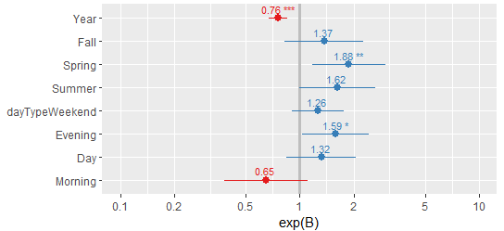
estimate std.error p.value conf.low conf.high exp.B.
3
conf.Low
Exp
conf.High
Exp
Intercept
551.088 | 120.171 | 4.52E-06 | 318.342 | 790.086 | 2.16E+239 | 1.80E+138 | Inf
Year
-0.276 | 0.059 | 3.53E-06 | -0.395 | -0.161 | 0.758 | 0.673 | 0.851
(ref = Winter) Fall
0.315 | 0.257 | 0.220 | -0.184 | 0.829 | 1.371 | 0.831 | 2.292
(ref = Winter) Spring
0.632 | 0.241 | 0.008 | 0.168 | 1.120 | 1.883 | 1.183 | 3.067
(ref = Winter) Summer
0.482 | 0.248 | 0.052 | 0.002 | 0.981 | 1.619 | 1.002 | 2.668
(ref= Weekday) Weekend
0.230 | 0.170 | 0.174 | -0.109 | 0.559 | 1.259 | 0.896 | 1.748
(ref = Night) Day
0.279 | 0.227 | 0.218 | -0.162 | 0.731 | 1.322 | 0.849 | 2.078
(ref = Night) Evening
0.461 | 0.218 | 0.0348 | 0.038 | 0.899 | 1.587 | 1.038 | 2.459
(ref = Night) Morning
-0.435 | 0.273 | 0.111 | -0.985 | 0.093 | 0.646 | 0.373 | 1.097
Temporal variations in crime occurrence: Tartu Municipality

Slide 17
Thank you !

